Slide 1
a game, shall we?
ui design programming 1
humay vahid

Slide 2
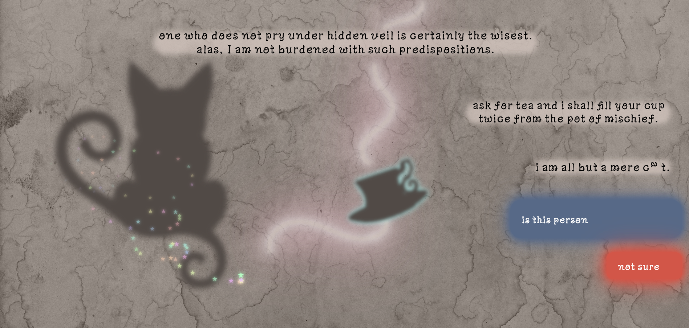
what is it?
a playful web-based game, where a mischievous cat answers your questions — right or wrong, who knows?
Notes:
interactive website, gamification, TikTok inspiration, mysterious cat

Slide 3
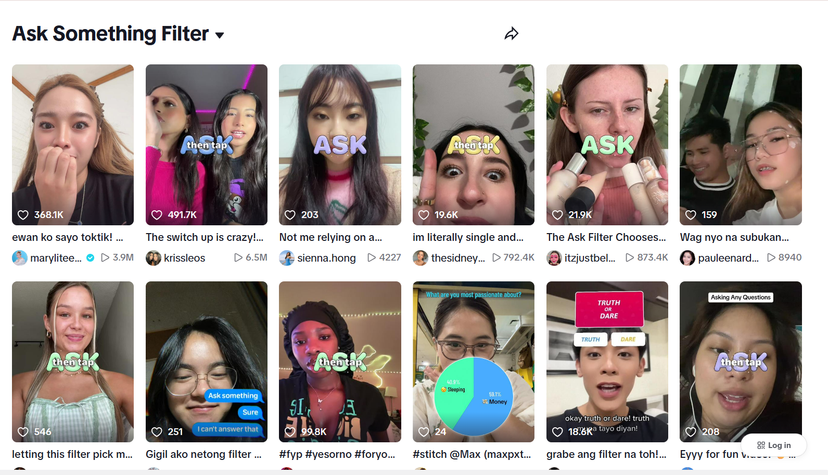
inspo..?
inspired by a tiktok filter where users receive random answers to fuel their storytelling, i translated this concept into an interactive website to encourage imagination and narrative play.
Notes:
TikTok storytelling, random answers, community play, trend adaptation

Slide 4



the gamification
the central figure of the game is a sly and whimsical cat — she responds to yes-or-no questions, but her answers may be misleading, adding mystery and fun to the ux.
Notes:
gamified interaction, character-based design (cat w 2 tails) , storytelling aid, unpredictable

Slide 5
design & interaction
the ui features poetic prompts, soft animations, glowing star trails, and a floating cat to enhance visual storytelling and reflect the game’s playful, mysterious tone.
Notes:
animations, custom typeface, rhymes, glowy stars, hover effects, themed branding

Slide 6
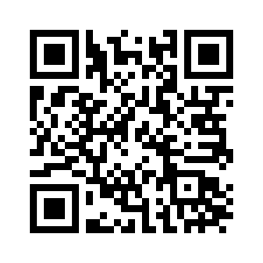
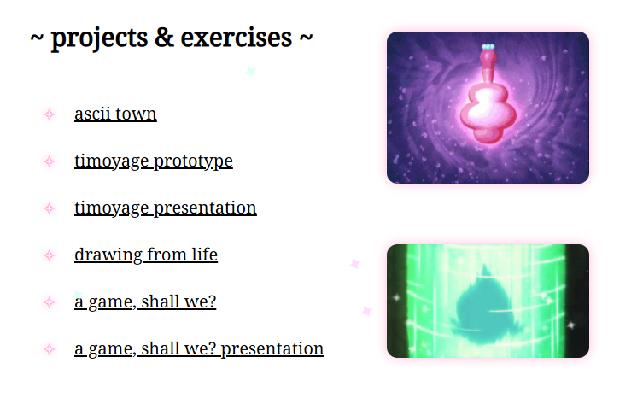
qr~~
감사합니다 <3 !!

